Slide 1

Azure Workshop
Introduction to Microsoft Azure

Slide 2
Azure Platform

Slide 3
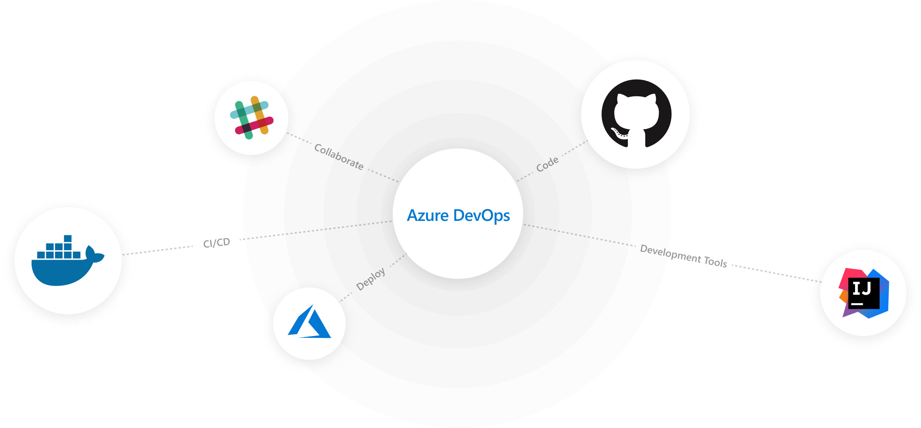








Azure DevOps
Azure DevOps
Plan smarter, collaborate better, and ship faster with a set of modern dev services.

Slide 4
Software Requirements

Slide 5
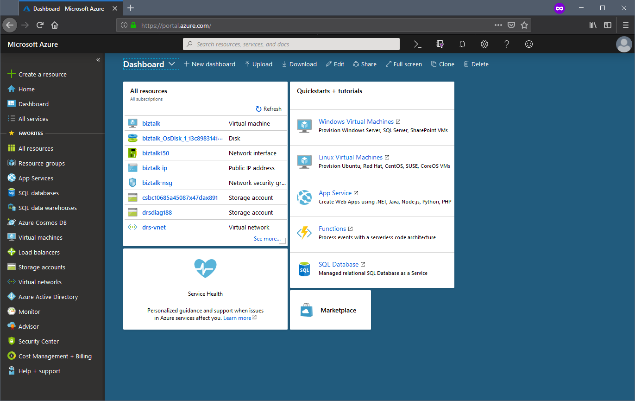
Azure Portal
https://portal.azure.com

Slide 6
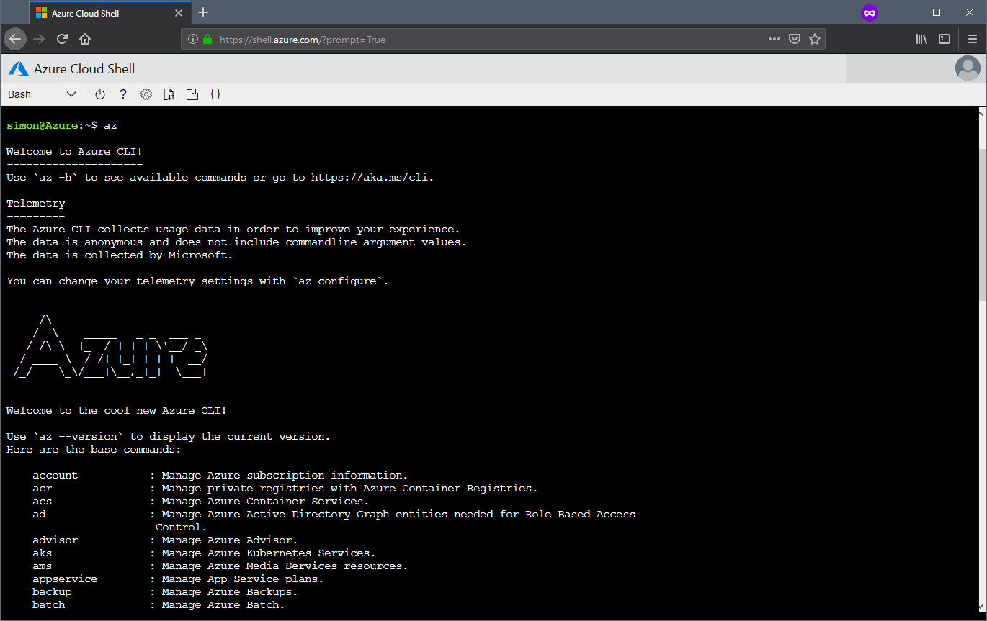
Azure Shell
https://shell.azure.com
https://docs.microsoft.com/en-us/cli/azure

Slide 7
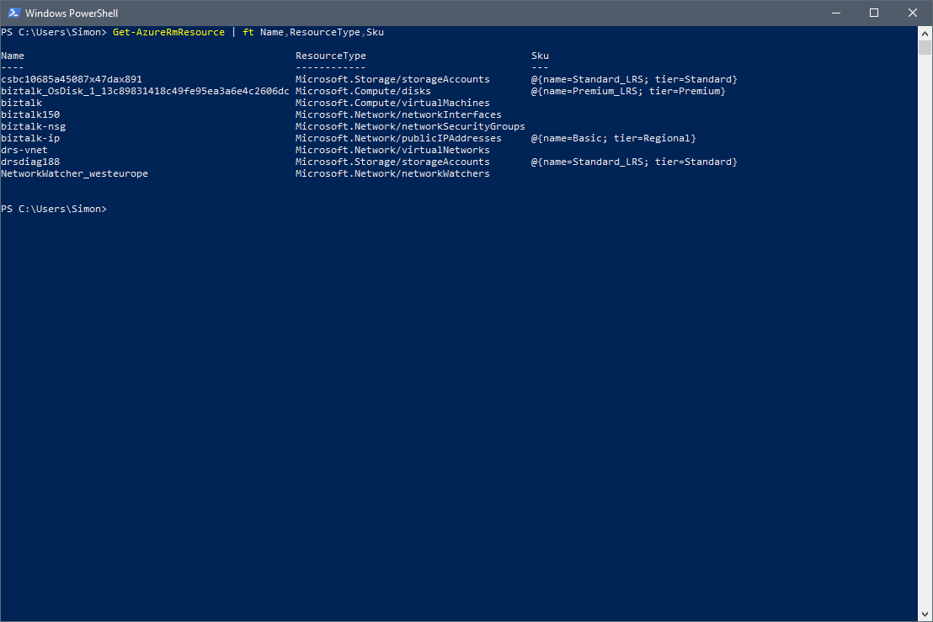
PowerShell
https://github.com/powershell/powershell
https://docs.microsoft.com/en-us/powershell/azure/overview

Slide 8
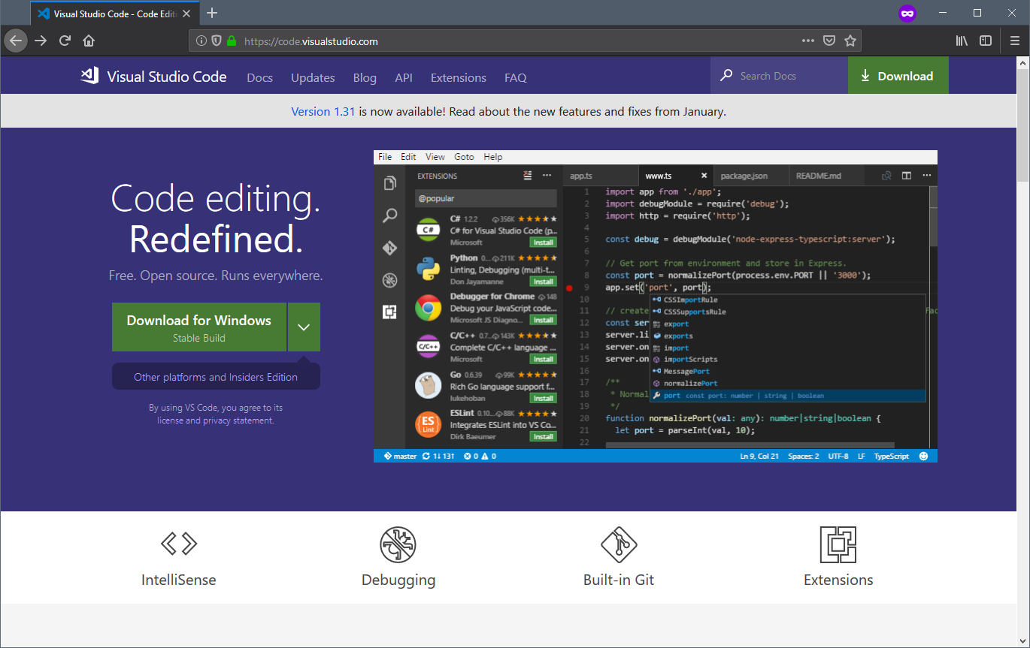
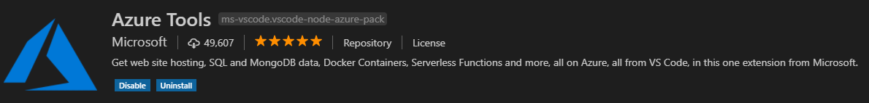
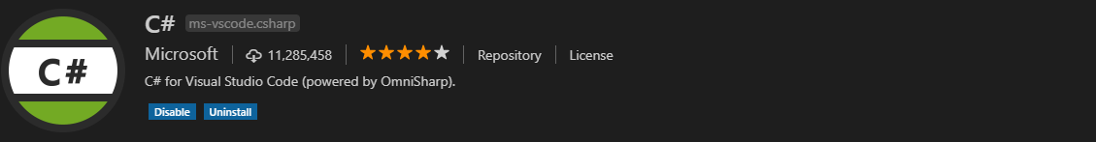
VS Code
https://code.visualstudio.com/

Slide 9
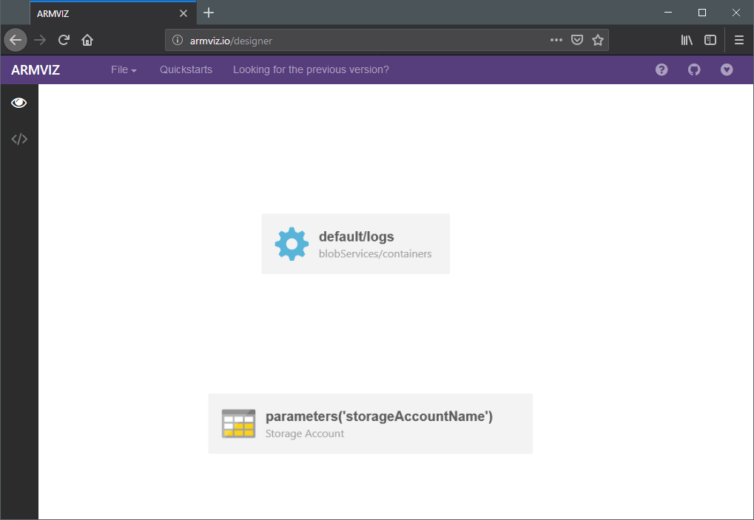
ARM Templates
https://github.com/Azure/azure-quickstart-templates
{
"$schema": "https://schema.management.azure.com/schemas/2015-01-01/deploymentTemplate.json#",
"contentVersion": "1.0.0.0",
"parameters": {},
"resources": [
{
"name": "[parameters('storageAccountName')]",
"type": "Microsoft.Storage/storageAccounts",
"apiVersion": "2018-07-01",
"location": "[parameters('location')]",
"kind": "StorageV2",
"sku": {
"name": "Standard_LRS",
"tier": "Standard"
},
"properties": {
"accessTier": "Hot"
},
"resources": [
{
"name": "[concat('default/', parameters('containerName'))]",
"type": "blobServices/containers",
"apiVersion": "2018-07-01",
"dependsOn": [
"[parameters('storageAccountName')]"
]
}
]
}
]
}

Slide 10
Workshop Overview
Data Storage
Web / App / Function
Networks
VMs
Containers
Service Fabric
Kubernetes
Security, Monitoring, Alerting
IoT, Stream Processing
Azure ML Studio, Cognitive Services

Slide 11


Certifications
Infrastructure (AZ-10X)
https://www.microsoft.com/en-us/learning/exam-az-100.aspx
https://www.microsoft.com/en-us/learning/exam-az-101.aspx
Development (AZ-20X)
https://www.microsoft.com/en-us/learning/exam-az-203.aspx
Architecture (AZ-30X)
https://www.microsoft.com/en-us/learning/exam-az-300.aspx
https://www.microsoft.com/en-us/learning/exam-az-301.aspx
DevOps (AZ-40X)
https://www.microsoft.com/en-us/learning/exam-az-400.aspx

Slide 12
Learning Resources
MSDN
O’Reilly Learning (Safari Books Online)
Azure Citadel (http://azurecitadel.com)
AI School (http://aischool.microsoft.com)
Azure Friday (https://channel9.msdn.com/Shows/Azure-Friday)
Udemy/Linux Academy
https://kepler.bjss.com/display/BCDF/Azure+-+Getting+Started

Slide 13
Sample Project

Slide 14
Web Application
Azure App Service Environment
ASP.NET MVC Application
KeyVault
Azure DevOps Deployment

Slide 15
Break into Teams

Slide 16
Start Hacking!

Slide 17
Recap & Progress

Slide 18
End.

